Slide 1
E-STORE
A project presented to you by Mridu Agrawal(01FB16ECS213) and Nachiketh Atawale(01FB16ECS217).

Slide 2
E-STORE
This website provides a small outlet of computer related accesories like Pcs,laptops and games for city residents at affordable prices.

Slide 3
TECHNOLOGIES USED
HTML
CSS
JAVASCRIPT
PHP

Slide 4
Key aspects
COD(Cash On Delivery)-Cash is the best kind of money there is ;)
Prices of all the commodities are on a 50% offer.
One Day Delivery(Free of cost)
Option for express delivery(within 12 hours) (Chargable)

Slide 5


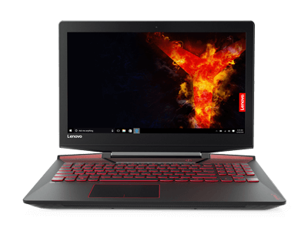
Laptops

Slide 6


Games

Slide 7
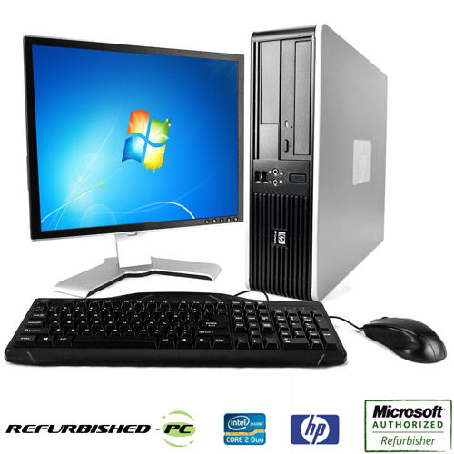
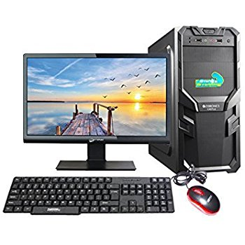
Desktop Computers

Slide 8
Thank you for your attention!!

